Slide 1
Analytics Related Integration Standard

Slide 2
Analytics APIs Justification: Decision Tree for API Implementation
Current Requirements:
First Analytics Serving API for CCMS
Requires standard for real-time Analytics Ingestion API
Channel/s require a new real-time business function
Business function can be provided by existing application/s?
no
Package Solution fulfilled the business function available?
yes
yes
Business function is fulfilled by multiple application?
yes
no
no
Implement business function as Process API in iPaaS
yes
Guarantee Delivery/Load Balance/Scheduling required?
Implement Business function as Data API in provider application
Implement business function as Data API with package solution
Implement business function as Microservice
no
no
Provider Application
supports standard protocol ?
yes
Consumer channel/s is/are
Internal/External?
Reusable/Extensibility analysis for future usage:
Full set of Document APIs are required for consumer channel/s to refer to the document recorded
The Doc APIs are designed to support OMNI channels
Exposed as IAPI in APIM
(Internal)
Internal
External
Exposed as EAPI in APIM
(External)
Notes:
`TE

Slide 3
Standard Integration pattern | SIP-DI002 – Ingestion
Business Scenario | To send business event/data to analytics system in real-time or batch
Known-Use: Push IOT Sensor’s data for analytics purpose (e.g. train the ML model) Push delta change data from source systems for analytics purpose Collection Web analytics data for analytics purpose (e.g. Google Analytics) Application monitoring data/ instrumentation records collection for real-time reporting/alert purpose
Systems support API Call Out
Systems support Messaging
Systems support Command Line (for batch or mini batch)
Description | Source System push business event data to analytics system via API or Messaging in real-time basis
Protocol | JSON/HTTPS/JMS/MQTT/AMQP (Source System to Event Hub) Proprietary protocol for agent and event sink communication
Messaging Pattern | [MSP-MC002] Request with ack. [MSP-MC003] Asynchronies messaging
Message Format | JSON / REST Structural ASCII STRING (e.g. with delimiter)
Security Pattern | [SEC-AUT002] OAuth 2.0 Client ID Grant Type for API call from system centric process
Source System 1
Source System 2
Source System 3
1
Agent
2
3
API Gateway
Message Queue
(EAI)
Event Data Collector
Event Sink (e.g. Save to BLOG Storage, Save to DB, Put to Analytics Stream …etc.)
Description
Data is push from source system via API, Message Queue or Agent to Event Sink The Ingestion API shall accept a generic string and is source system agnostics Pulling Data directly from source system by process owned by Analytics System shall be avoided as of 0 or minimal reusable value of this mechanism
Stream Analytics
BLOB Storage
Notes:
TE

Slide 4
CLP Analytics Ingestion Pattern – Existing Projects Review
Review Case 1:
PI System LV Cable Fault Analytics Delta Data Ingestion
Target – Direct push to Azure Event Hub via API
[Review Result]: Conformed
PI Integrator (part of source system) prepare data and call AzCopy to ‘push’ the data to Azure Blog Storage
There is no dependency from Analytics layer on source system built for this approach
Source System
Review Case 2:
OPS Delta Data Ingestion
[Review Result]: Not Conformed
OPS (source system) provides Web Service to consume it’s data, so it’s a Pull Pattern
A Scheduled job customized for OPS need to be developed at Azure for Analytics ingestion purpose with minimal reusable value
Source System
Review Case 3:
SAP Delta Log Ingestion (batch)
[Review Result]: Conformed
THEEOBALO (SSIS Solution) prepares data and use PolyBase to ingest the data to Azure Blob Storage, it’s a Push Pattern without dependency job required from Analytics Layer
Source System

Slide 5
Standard Integration pattern | SIP-DI003 – Analytics Serving
Business Scenario | To serve the channels on analyzed data
Known-Use: Serving CCMS on analyzed data via API
Systems support consuming analyzed data proactively
Systems support event subscription mechanism
(passive mode)
Description | Analyzed data is publish from analytics system and allow consumers to access via API or subscription in real-time basis
Protocol | JSON over HTTPS (BLOB Storage/Data Lake to API) JSON over JMS/AMQP (BLOB Storage/Data Lake to Message Queue)
Messaging Pattern | [MSP-MC001] Synchronous Request with Response [MSP-MC003] Asynchronies messaging
Message Format | JSON / REST
Security Pattern | [SEC-AUT002] OAuth 2.0 Client ID Grant Type for API call from system centric process
Consumer System
Event Subscriber
1
2
API Gateway
Event Publish (EAI)
e.g. Push Notification, Email, callback URL … etc.
Message Queue (EAI)
1
2
Microservice
(Publish to Queue)
Microservice
(Publish to API)
Description
Analyzed Data is published from analytics platform to serve different channels The Serving API and the MQ message shall have a generic output interface (e.g. key-value pairs JSON structure) for the ease of extensibility In overall, it’s a push pattern driven by new analyzed data creation in analytics platform
BLOB Storage
Stream Analytics
Notes:
TE

Slide 6



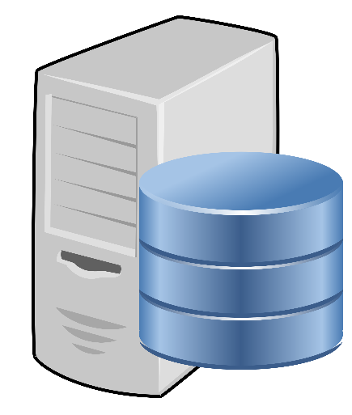
CLP Analytics Serving Pattern – Existing Project - MSBI Review
[Review Result]: Conformed
The Analytcs result API is published in APIM, firstly used by CCMS, and can be consumed by other channels in the future
API key/SSL
APIgee Edge
(API Proxy)
API key/SSL
REST API
Port 443
API Call
Port 443
Azure Function
Serverless Job @CLP’s vNET
CCMS
(SAP)
VMs @CLP’s vNET
CSV
JSON
BLOB Storage
PaaS @CLP’s vNET
CSV
VM On premises
CCMS
(SAP)
Notes:
TE

